Slide 1
Determination of g from free fall
Clamp Stand
Light Gate
Equipment
Data Logger
Ruler
Table
0.00
Wire
Weighted Card

Slide 2
Determination of g from free fall
0.00

Slide 3
Equipment models
Alone
Clamp Stand
Light Gate off
Wire
Data Logger
Ruler
Weighted Card
Combined
Clamp Stand, Light Gate off
Clamp Stand, Ruler
Clamp Stand, Ruler, LGOFF
Clamp Stand, Ruler, LGOFF, wire
Clamp Stand, Ruler, LGOFF, Timer
Clamp Stand, Ruler, LGON, wire, Timer

Slide 4
Order of creation
Add Clamp Stand
Add the light gate
Add the ruler
Add the timer
Add the wires

Slide 5
Positions of objects in final
Object | X | Y | Z | Q1 | Q2 | Q3 | Q4
Timer | -4.926 | 2.3419 | 4.103
Light Gate
Wires
Clamp Stand | -5.051 | 2.206 | 5.227
Ruler

Slide 6
Positions of objects in final 2
Object | X | Y | Z | Q1 | Q2 | Q3 | Q4
Clamp Stand | -5.057 | 2.206 | 5.218
Clamp Stand Light Gate | -5.052 | 2.207 | 5.226
Ruler | -5.056 | 2.21 | 4.232
Timer | -5.089 | 2.22 | 4.227
Wires | -5.06 | 2.206 | 4.224

Slide 7
Distance | X | Y | Z | Q1 | Q2 | Q3 | Q4
10 | -5.193 | 2.9591 | 5.553 | -90 | -90 | 0
20 | -5.193 | 3.1594 | 5.553
30 | -5.193 | 3.3559 | 5.553
40 | -5.193 | 3.5514 | 5.553
50 | -5.193 | 3.7547 | 5.553

Slide 8
https://pnghut.com/png/csaq31idUJ/rubbish-bins-waste-paper-baskets-recycling-bin-black-and-white-symbol-transparent-png - bin asset

Slide 9
Drag and drop here to delete
Select the correct SUVAT Equation
Drag and drop into the correct places

Slide 10
1073, -473
1191, -473
1073, -607
1191, - 607

Slide 11
X position of arrow
Position | X Position
0 | -647.6
10 | -395
20 | -137
30 | 119
40 | 373
50 | 631

Slide 12

NOTES

Slide 13
https://www.youtube.com/watch?v=waEsGu--9P8&t=625s
Grid layout video

Slide 14
The assets
Wires
Ruler
Desks
Clipboard

Slide 15
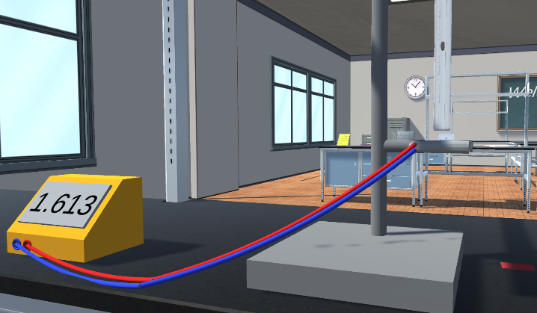
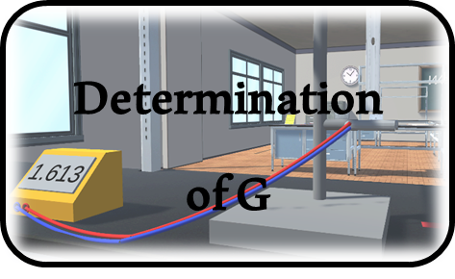
Determination of G
Coming Soon
Practical
Selection
Start Experiment

Slide 16
Equation Rearranging
SUVAT Equations
We have our values, but wait, we need to figure out how to plot our graph
Here are the SUVAT equations of motion, which one could we use?
Correct, this equation uses the components that we have and need
s = ½(u + v)t
We need this equation in the form y = mx + c
v = u + at
s = vt – ½at²
s = ut + ½at²
v² = u² + 2as

Slide 17
2a
v²
u²
s
Select the correct SUVAT Equation
Please move through our tutorial or skip if you are an experienced user

Slide 18

Use the WASD keys to move around the room
Skip
W
1 of 6
Use the mouse to look around
A
S
D
Use left mouse button to interact with the environment
Hold left button to pick up an object when ‘Pick Up’ appears and release to drop
Release mouse button over the build area to put together the apparatus

Slide 19
i
To return to the main menu press ESC
Main Menu
To return to the main menu press ESC
Continue
To replay this tutorial, press tutorial in the menu
Tutorial
Settings
Quit Game

Slide 20
Determination of G
Determination of G
Use light gates and a ruler to drop a card and multiple heights in order to determine the acceleration caused by gravity.
https://clara.io/view/b8a8fb8d-cfe7-4e5d-a219-e26f862feb42# - arrow model
Skills Assessed:
Taking multiple results
Tabulating Results
Anomaly detection
Graphical Analysis
Change in y over change in x diagram - https://www.mathsisfun.com/calculus/derivatives-introduction.html

Slide 21
Example Table
Height (m)
Time (s)
Time (s)
Time (s)
Average Time (s)
Velocity (m/s)
0.1
Remember to put the unit in brackets in the header. These should be in SI units
0.2
17.2
18.1
29.1
0.3
0.4
0.5
Once you have collected your results, it is important to remove and repeat any anomalous results
B
E
A
C
D

Slide 22
Audio Assets
Click - https://freesound.org/people/stijn/sounds/43686/
Paper - https://freesound.org/people/InspectorJ/sounds/416179/
Footsteps - https://freesound.org/people/mmaruska/sounds/180650/
Whoosh - https://freesound.org/people/SlavicMagic/sounds/446010/
Whoosh 2 - https://freesound.org/people/InspectorJ/sounds/394433/
Whoosh 3 – whoosh edited
Piano - https://freesound.org/people/IESP/sounds/340062/

Slide 23
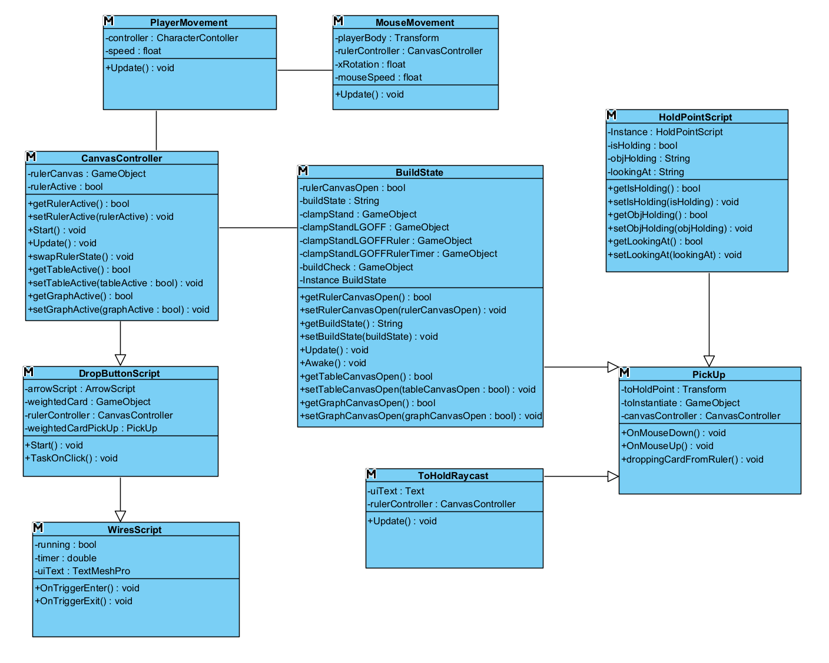
Build 1 Class Diagram

Slide 24
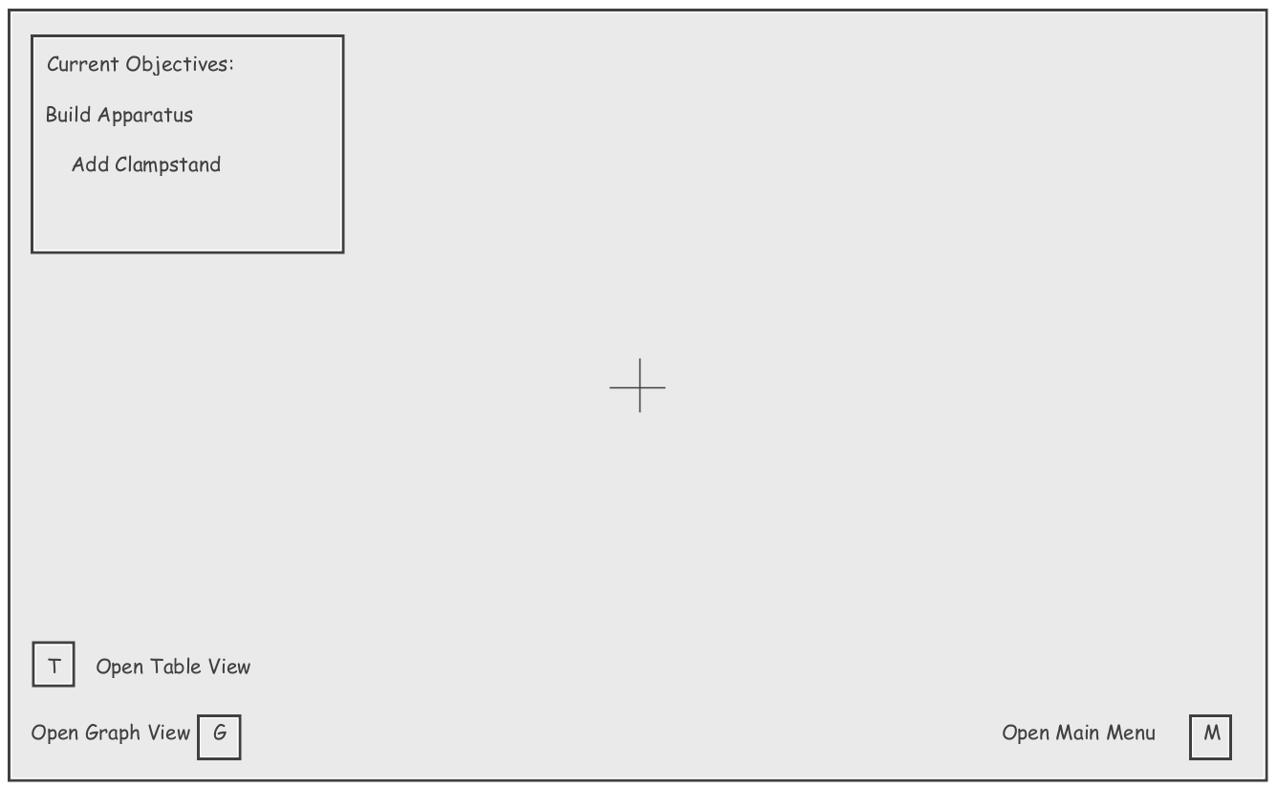
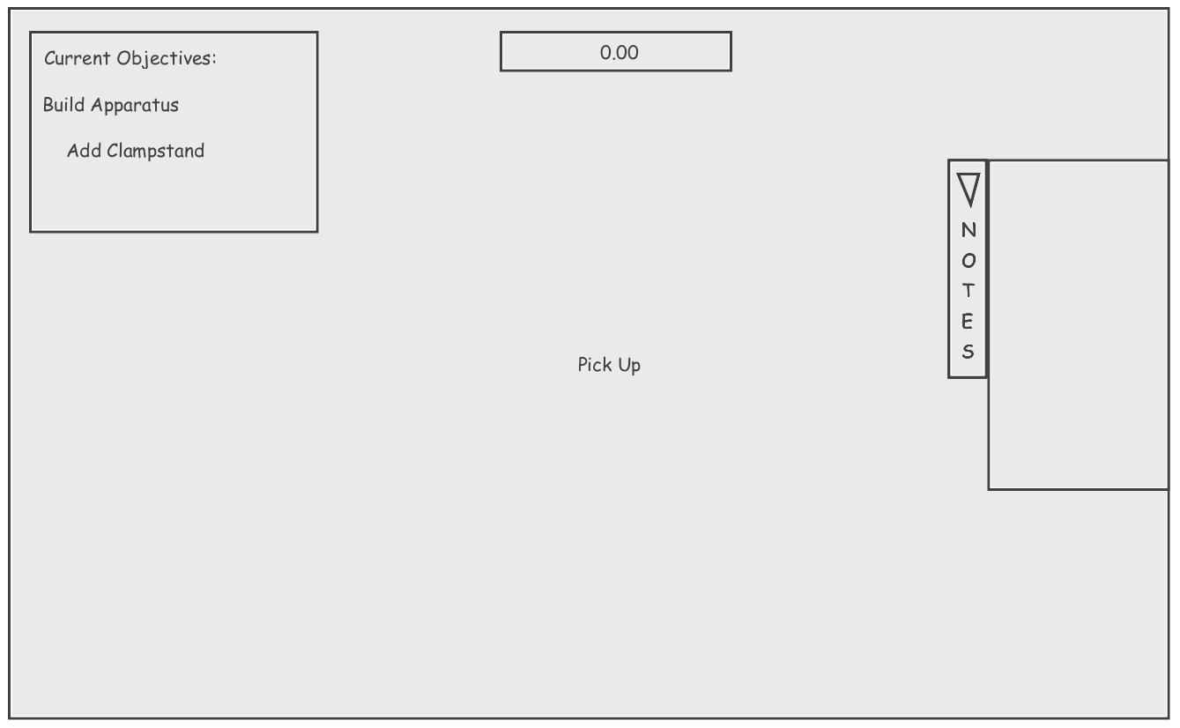
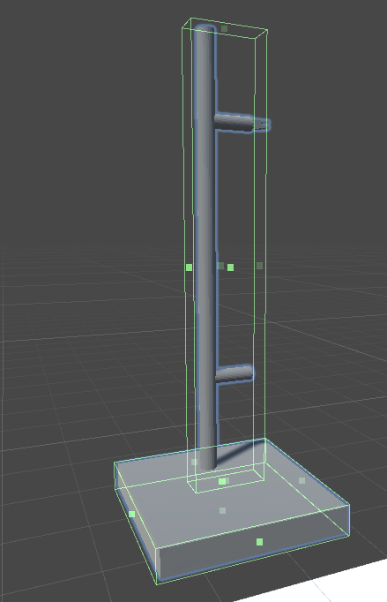
Initial UI Design
Final UI Design
Box Colliders on Clamp Stand

Slide 25
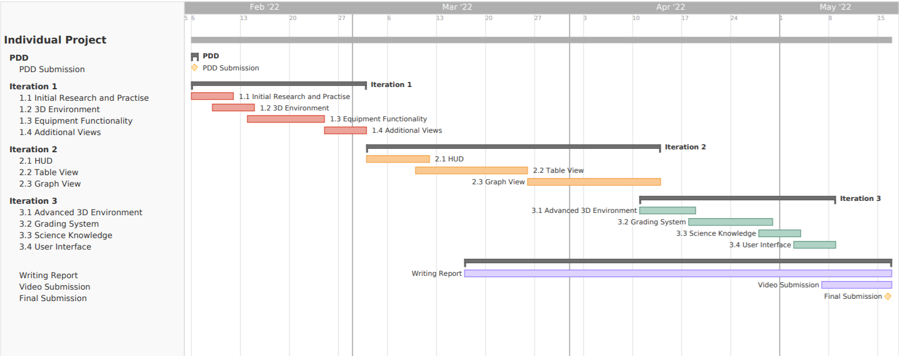
Gannt Chart showing project timeline

Slide 26
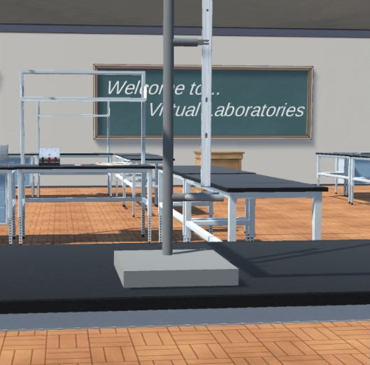
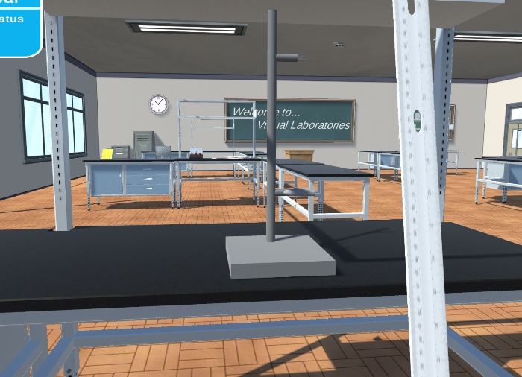
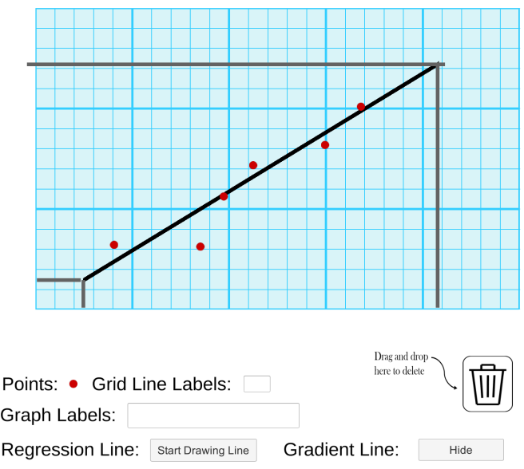
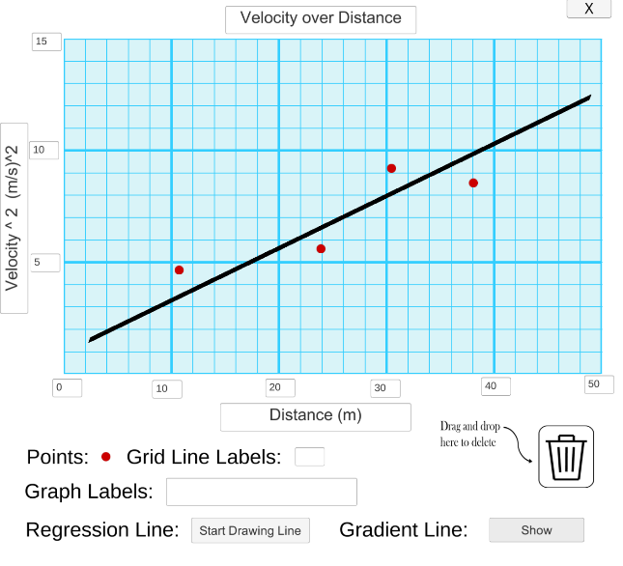
Apparatus stage of ClampStand,LGOFF,Ruler
Apparatus stage of ClampStand,LGOFF with the player holding the ruler
Graph View with Completed Graph and Gradient Lines to Calculate X and Y Differences
Graph View with Completed Graph

Slide 27
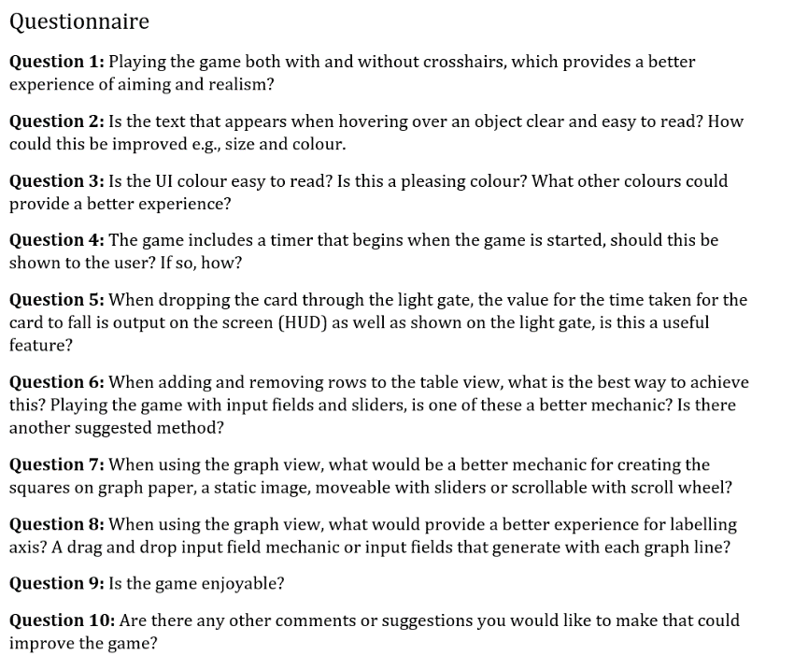
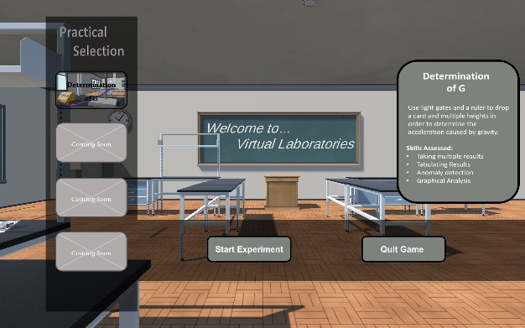
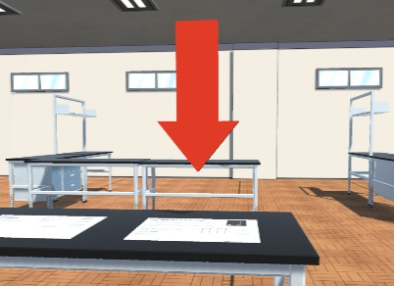
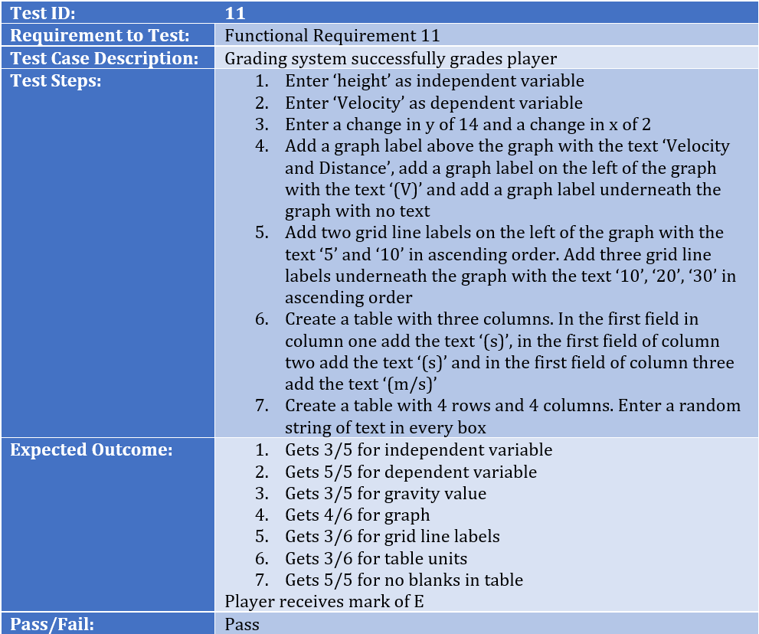
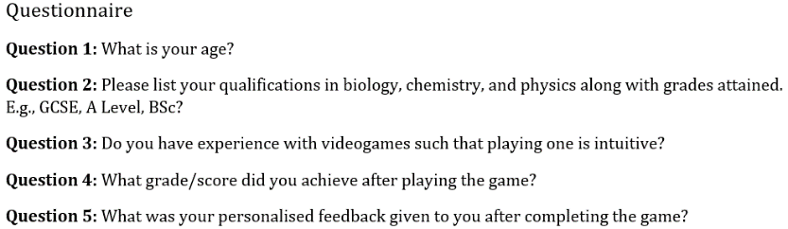
Bouncing Arrow
Main Menu Scene
User Feedback Questionnaire Questions
Evaluation Questionnaire Questions
Test Case for Functional Requirement 11

